Slide 1
Neuroevolution in Games: State of the art and open challenges
A summary
Eleysa Emily huil
17124660/1 (WID170009)

Slide 2
Introduction of neuroevolution

Slide 3
Neuroevolution (NE) refers to the generation of artificial neural networks using evolutionary algorithms.
This technique has been implemented in robot control, music generation, modelling biological phenomena and chip resource allocation among many others.
NE is widely use because many AI and control problem can be cast as optimization problems, where what is optimized is a general function approximator.
NE is motivated by the evolution of biological nervous system and applies abstractions of natural evolution to generate artificial neural networks.
The basic idea of behind NE is to train the network with an evolutionary algorithm, which is a class of stochastic, population-based search methods inspired by Darwinian evolution.

Slide 4
Basic algorithm
A population of genotypes that encode ANNs is evolved to find a network that can solve a computational problem.
Typically each genotype is encoded into a neural network, which is then tested on a specific task for a certain amount of time.
The performance or fitness of this network is then recorded and once the fitness values for the genotypes in the current population are determined, a new population is generated by slightly changing the ANN-encoding genotypes or by combining multiple genotypes.
(Genotypes with higher fitness have a higher chance of being selected for reproduction and their offspring replaces genotypes with lower fitness values, thereby forming new generation.)

Slide 5
Why neuroevolution?
1.Record-Beating Performance
2. Broad Applicability
3. Scalability
4. Diversity
5. Open-Ended Learning
6. Enables New Kinds of Games
An example of the disadvantages of NE includes that the evolved neural networks tend to have “black box” characteristic, meaning that a human cannot easily work out what they do by looking at them.

Slide 6
Role of neuroevolution
State/Action Evaluation
Direct Action Selection
Selection Between Strategies
Modelling Opponent Strategy
Content Generation
Modelling Player Experience

Slide 7

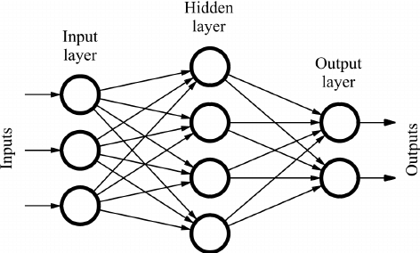
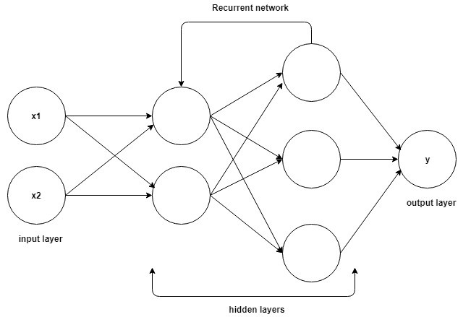
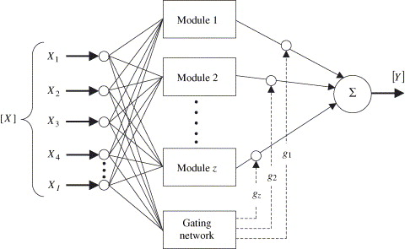
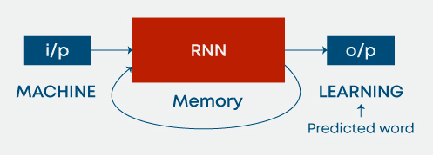
Neural network types
I. Feedforward
-The information travels directly from the input nodes through the hidden nodes to the output nodes.
II. Recurrent Networks
-The networks can form loops and cycles, which allows the information to also be propagated from later layers back to earlier layers.
-Recurrent network can have memory, whereas static feedforward networks livew in an eternal present.
III. Modular Networks
-Composed of number of individual neural networks, in which the modules are normally responsible for a specific sub-function of the overall system.
IV. Long-Short Term Memory (LSTM) network
-Instead of changing connection weight, LSTM networks can learn by remembering values for an arbitrary amount of time.

Slide 8
evolving NEURAL NETWORKS
The earliest NE methods (sometimes called conventional neuroevolution, CNE) only evolved the weight of a network with a fixed user-defined topology and in the simplest direct representation, each connection is encoded by a single real value.
A significant drawback of the fixed topology approach is that the user has to choose the appropriate topology and number of hidden nodes a priori.
For example, Neuroevolution of Augmenting Topologies (NEAT) which has shown that also evolving the topology together with the connection weights often outperforms approaches that evolve the weight alone.
This methods allow evolution of recurrent networks that can solve difficult non-Markovian control problems.
Both the fixed-topology and topology-evolving approaches above use a direct encoding, meaning that each connection is encoded separately as a real number.
Indirect encoding has also been gaining popularity which allow the reuse of information to encode the final network and thus very compact genetic representations.
A promising indirect encoding that has been employed successfully in a variety NE-based games are CPPNs.

Slide 9
Fitness evaluation
The fitness of a board value estimator or ANN controlled NPC is traditionally determined based on its performance in a particular domain.
In many cases it is possible to evolve good behavior using a straightforward fitness function like the score of the game, which has the advantage that such fitness functions can typically not be “exploited” in a way composite fitness functions sometimes can.
When the problem becomes too complex it can be difficult to evolve the necessary behavior directly, it can be helpful to learn them incrementally, by first starting with a simple task and gradually making them more complex; this is usually called staging and/or incremental evolution.
A form of training that can be viewed as a more radical version of incremental evolution is transfer learning. The goal is to accelerate the learning of a target task through knowledge gained during learning of a different but related source task.
Competitive Coevaluation is a method that can potentially circumvent a more complex problem in which the fitness of one AI controlled player depends on its performance when competing against another player drawn from the same population of from another population.
There is also cooperative coevaluation. Whereas in competitive coevaluation fitness is negatively affected by the success of other individuals, in cooperative coevolution it is positively effected.

Slide 10
Input representation
Straight Line Sensors and Pie Slice Sensors
Angle Sensors and Relative Position Sensors
Pathfinding Sensors
Third-Person Input
Learning From Raw Sensory Data

Slide 11
Open challlenges
Reaching Record-Beating Performance- Breaking records using NE
Comparing and Combining Evolution with Other Learning Methods-comparing and combining other methods and NE is a good way to achieve optimum result.
Learning from High-Dimensional/Raw Data-making more advances in using raw data in training ANNs.
General Video Game Playing-Apart from the Atari GGP benchmark, another relevant benchmark here is the General Video Game Playing Competition, which uses games encoded in the Video Game Description Language (VGDL).
Combining NE with Life-Long Learning-An even larger stap would to be evolve a single neural network that could learn and adapt during its lifetime to play one of a set of games.
Competitive and Coorperative Coevalution- Competitive coevolution could in theory enable open-ended evolution through arms races; cooperative coevaluation could help find solution to complex problems through auntomatically decomposing the problems and evaluating partial solutions by how well they fit together.
Fast and Reliable Methods for Commercial Games-For example, ANNs have mostly found their way into commercial games for data mining purposes, with a few exceptions of usage for NPC control in games such as Black&White or the car racing game Collin McRae Rally 2.

